Slide 1
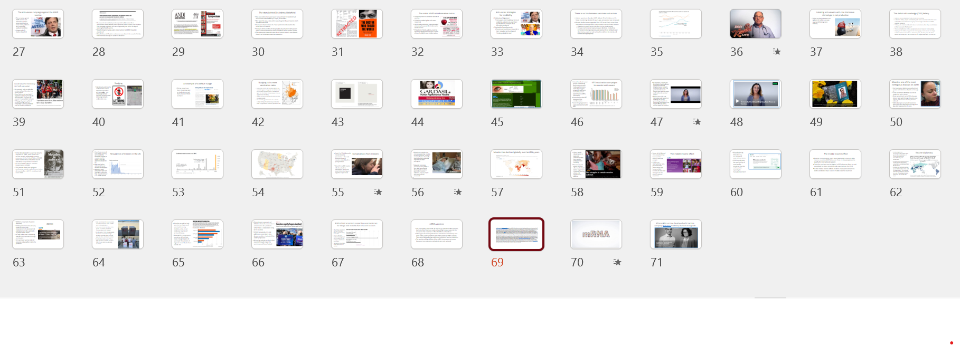
If you aren’t coming to lecture on Monday and Wednesday mornings…
…you didn’t have the full content for the midterm and you won’t get the full content for the final exam. For this week’s lectures on vaccines you are missing around 70 slides of content available only in class:

Slide 2
Vaccines pit collective societal good versus individual interests
As vaccines reduce disease transmission, they indirectly protect the community, including individuals who are too young to get vaccinated, and the immunocompromised
Yet individuals have incentives to refrain from vaccination, to act in their self-interest. They can free ride and profit from indirect protection of others who vaccinated.
When more people decide to refrain from vaccination, their individual choices can create scenario for disease to emerge, persist, and cause harm
Notes:
Vaccines ask us to consider social welfare and not just mere self-interest

Slide 3
Anti-vaxx sentiment is not new
In 1902, Swedish-American pastor Henning Jacobson refused the smallpox vaccine, arguing the mandate violated personal liberty.
In Jacobson v. Massachusetts (1905), the Supreme Court ruled against Jacobson and upheld the state’s authority to require vaccination to protect public health.
In Zucht v. King (1922), Rosalyn Zucht, a Texas schoolgirl, challenged her exclusion from school for lacking required vaccinations.
The Supreme Court ruled against Zucht, affirming that states and cities may require vaccination—such as for school attendance—even when no outbreak is occurring.

Slide 4
Reasons for hesitancy and anti-vaxxer attitudes
People who believe strongly in all-natural foods and medicines for them or their children
Religions that oppose vaccines
Mistrust in the authority of science and institutions affiliated with it
Cultural amnesia: when there is little cultural memory of diseases and their negative effects then vaccines may seem unnecessary
Political views that put individual choice above societal concerns
Distrust of power and events of history like colonialism or racism that make people unwilling to vaccinate

Slide 5
There is no link between vaccines and autism
Autism spectrum disorder (ASD) affects 2% of children in US. Since monitoring started 20 years ago, prevalence has increased
Recent studies have suggested that ASD most likely arises from interactions among genetic and prenatal environmental factors:
Mutations in genes may be inherited or arise spontaneously
Prenatal environmental exposures span infections, medications, complications during pregnancy, and exposure to air pollutants and other toxins, as well as maternal health conditions like obesity and diabetes during pregnancy
Notes:
https://onlinelibrary.wiley.com/doi/full/10.1002/bies.202000307 https://journals.plos.org/plosone/article?id=10.1371/journal.pone.0289841
https://www.healthychildren.org/English/safety-prevention/immunizations/Pages/Vaccine-Studies-Examine-the-Evidence.aspx Children with autism and/or ADHD have a reduced ability to clear out the common plastic additive bisphenol A

Slide 6
Full global components of the Pfizer BioNTech mRNA Covid vaccine
Genome sequencing of virus and its public release (China)
Refinement and verification of genomic sequence (Australia, US, Europe, Asia)
Initial research on mRNA vaccines conducted the National Institute of Health (US)
Clinical trials (US, Germany, Turkey, Argentina, Brazil, and South Africa)
Manufacturing (Belgium, Germany, US-Michigan):
Regulatory Approvals (Worldwide): Rapid, coordinated review by UK, EU, U.S., Canada, WHO, and many others enabled global rollout.

Slide 7
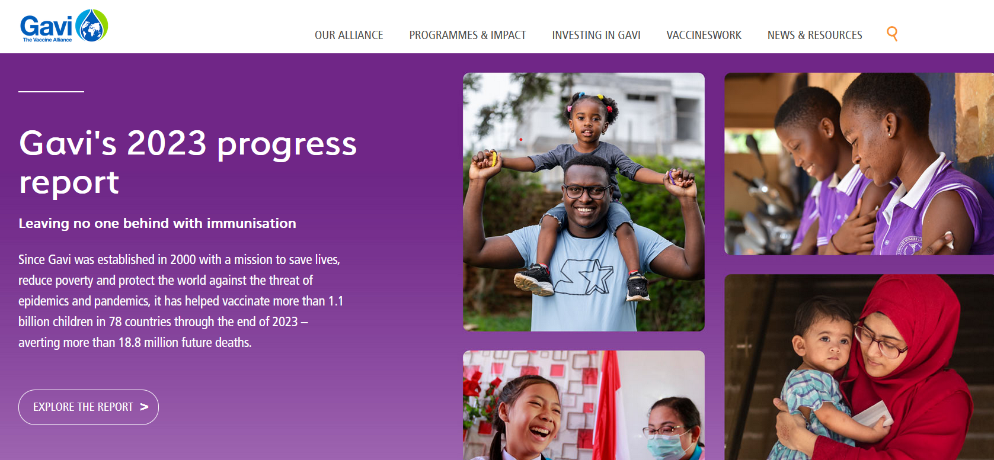
The middle income effect
Focus of childhood immunization has been on the world’s poorest people.
GAVI is an international non-governmental association that has provided billions of low-cost vaccines to the world’s poorer countries
Notes:
Berkley, S. "Vaccination lags behind in middle-income countries." Nature 569.7756 (2019): 309. Global Alliance for Vaccines and Immunization
https://www.gavi.org/

Slide 8
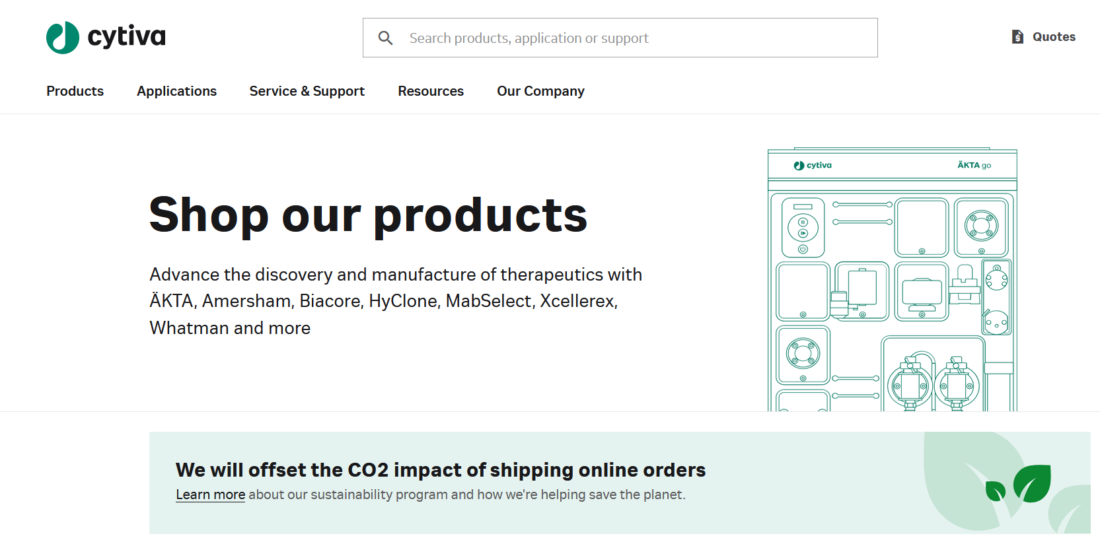
Manufacturing vaccines is a complex and expensive process
GAVI coordinates the availability of vaccines for countries that do not have the capacity to manufacture them
Notes:
https://www.cytivalifesciences.com/en/us/shop

Slide 9
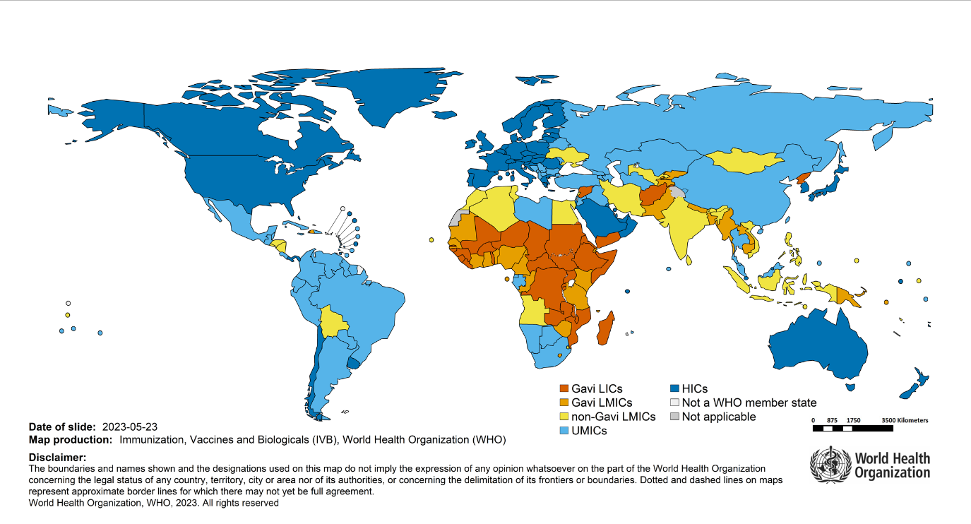
The middle income effect
Routine immunization levels have stagnated in many middle income countries (MICs) because they are too prosperous to qualify for international support from GAVI
Notes:
Berkley, S. "Vaccination lags behind in middle-income countries." Nature 569.7756 (2019): 309.
Costs for vaccines are thus higher in MICs because they are not subsidized
In the middle income effect, children in weakest economies better protected than in some middle income countries

Slide 10
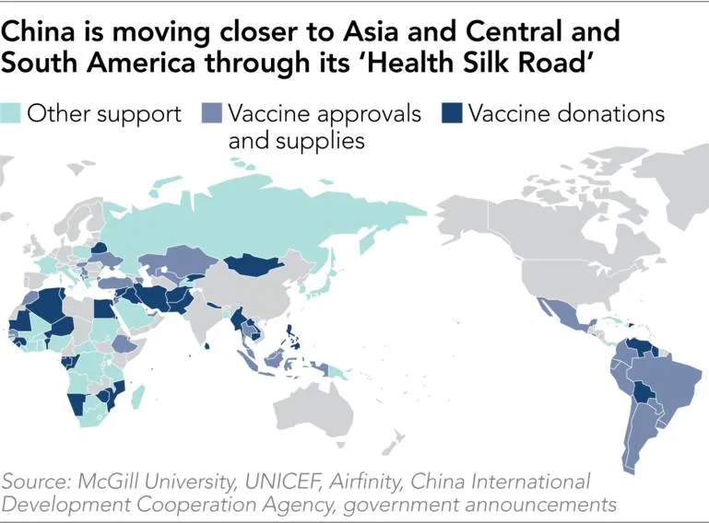
Vaccine diplomacy
Encompasses the politics that go into the coordination of vaccine development, manufacturing, and distribution.
Involves national governments, multinational corporations, universities, and global entities like the WHO
Vaccines can reinforce existing power relationships or be used to realign them
For example, China has provided its vaccines as a way of exerting economic influence – the Chinese ‘health Silk Road’
Notes:
https://asia.nikkei.com/Spotlight/Datawatch/China-emerges-as-big-winner-in-vaccine-outreach

Slide 11
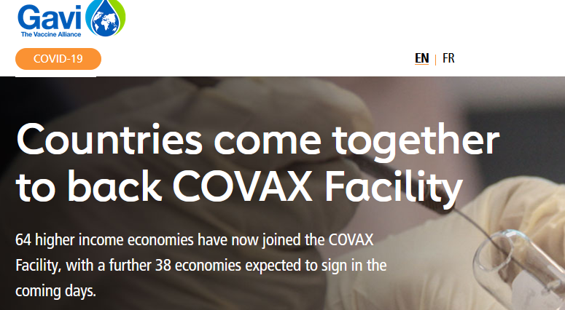
COVAX
COVAX is an example of vaccine diplomacy
COVAX pooled resources of many countries to promote cooperation in the development and deployment of Covid vaccines to all people of the world
Aim was lower vaccine costs for everyone and a swifter end to the pandemic
Notes:
https://www.gavi.org/vaccineswork/gavi-ceo-dr-seth-berkley-explains-covax-pillar

Slide 12
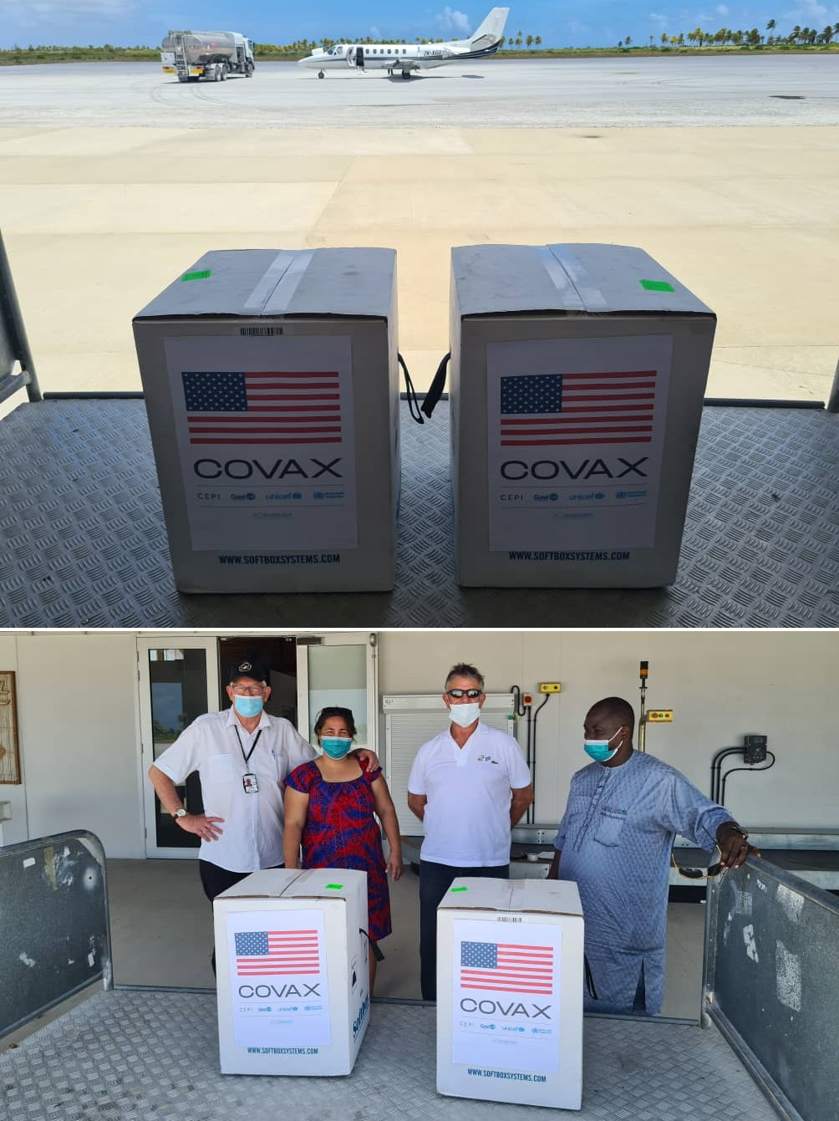
However, COVAX fell short of its goals
Powerful countries prioritized vaccines for their own citizens
By end of 2021, more people had been vaccinated in high-income countries than in more populous low-income countries
Vaccination rates were 75% in high-income countries, but less than 2% in some low-income countries.
Notes:
https://www.nytimes.com/reuters/2020/09/03/world/asia/03reuters-health-coronavirus-vaccines-covax-exclusive.html

Slide 13
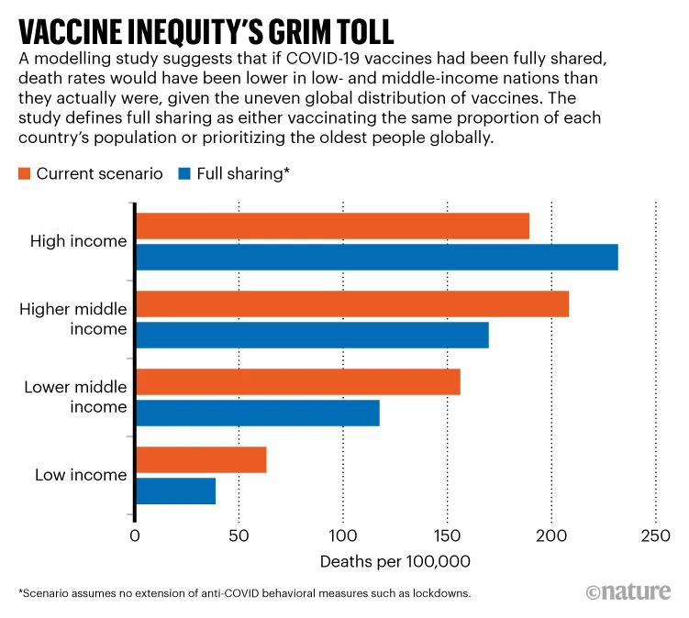
Wealthy countries had vaccine surpluses and vaccinated young children, who are at relatively low risk of serious disease.
Meanwhile, many poorer countries still did not have enough supply to vaccinate the people at highest risk of death from COVID-19.
Notes:
Low- and middle-income nations would have had lower death rates if vaccines had been shared more equitably. Equitable vaccine coverage could have prevented 1.3 million deaths worldwide. More than twice that many deaths would have been avoided if higher-income countries had also stuck with other measures to reduce transmission. https://www.nature.com/articles/d41586-022-03529-3

Slide 14
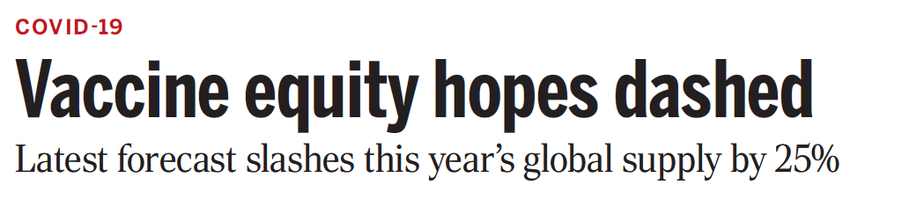
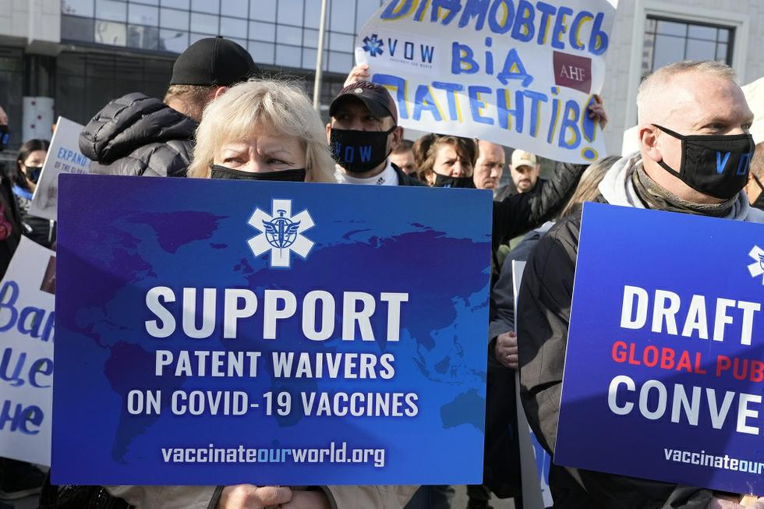
Approach of COVAX criticized as short-term fix rather than long-term solution
COVAX had good aims but addressed symptom of deeper problem instead of underlying cause
Releasing patents so that other countries could make the mRNA vaccine would have helped
Notes:
One such approach that is to waive patent protections so that new mRNA vaccines can be manufactured in other countries, lessening the dependence upon wealthier nations to provide them
Releasing patents on COVID vaccines would likely have increased global vaccination rates, especially in low- and middle-income countries, by enabling local production, lowering costs, and reducing dependence on international supply chains. Patent restrictions limited vaccine availability by concentrating production in a few countries, making doses less accessible and more costly for many nations. Local manufacturing could have met demand faster and reduced logistical challenges associated with vaccine distribution. While concerns about quality control and innovation incentives exist, many argue that, given the public health stakes and public funding in vaccine development, global access should have been prioritized.

Slide 15
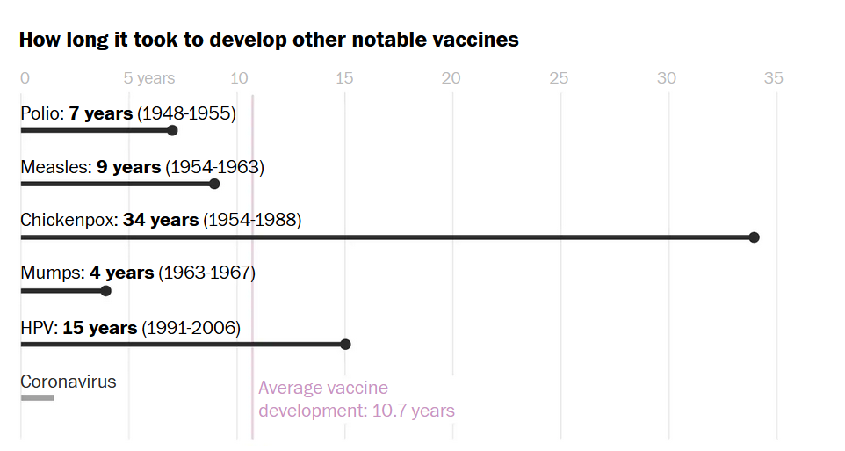
Global cooperation aided the design and manufacture of mRNA Covid vaccines
The Pfizer (US) mRNA vaccine took less than a year to bring to market.
Prior, fastest development of a vaccine was for mumps, which took four years
Ties across countries around the world were necessary to do this
Notes:
https://www.washingtonpost.com/graphics/2020/health/covid-vaccine-update-coronavirus/

Slide 16
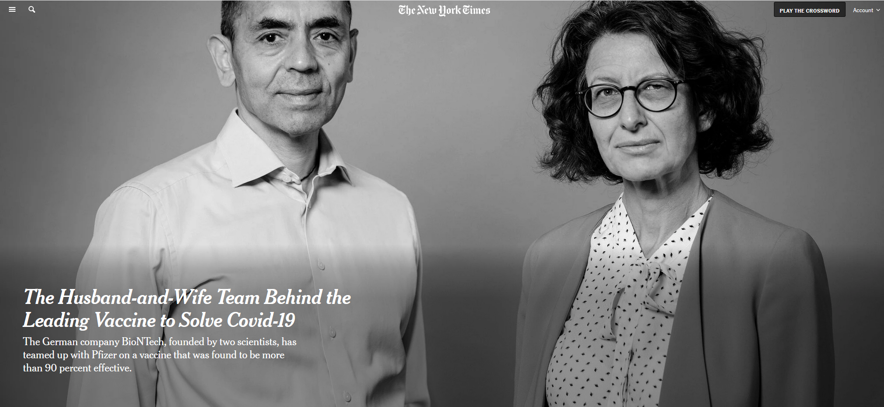
Pfizer mRNA vaccine invented by German company BioNTech started by Turkish immigrants
Notes:
https://www.nytimes.com/2020/11/10/business/biontech-covid-vaccine.html BioNTech coordinated the development of their mRNA vaccine with Pfizer, an American company
BioNTech was co-founded by Dr. Uğur Şahin and Dr. Özlem Türeci, a married couple of Turkish descent. Dr. Şahin was born in İskenderun, Turkey, and moved to Germany at the age of four to join his father, who worked at a Ford factory in Cologne. Dr. Türeci was born in Germany to a Turkish physician who had immigrated from Istanbul. Together, they established BioNTech in 2008, focusing on individualized cancer immunotherapy and later developing one of the first COVID-19 vaccines.

Slide 17

Advantages of mRNA vaccines
Can be designed and manufactured faster than traditional methods (they require mammalian cell cultures or chicken eggs)
Fewer impurities
Allows for faster response to disease outbreak
Do not contain any live or weakened virus
Induces strong immune response
The technology won a Nobel Prize in Physiology or Medicine in 2023

Slide 18
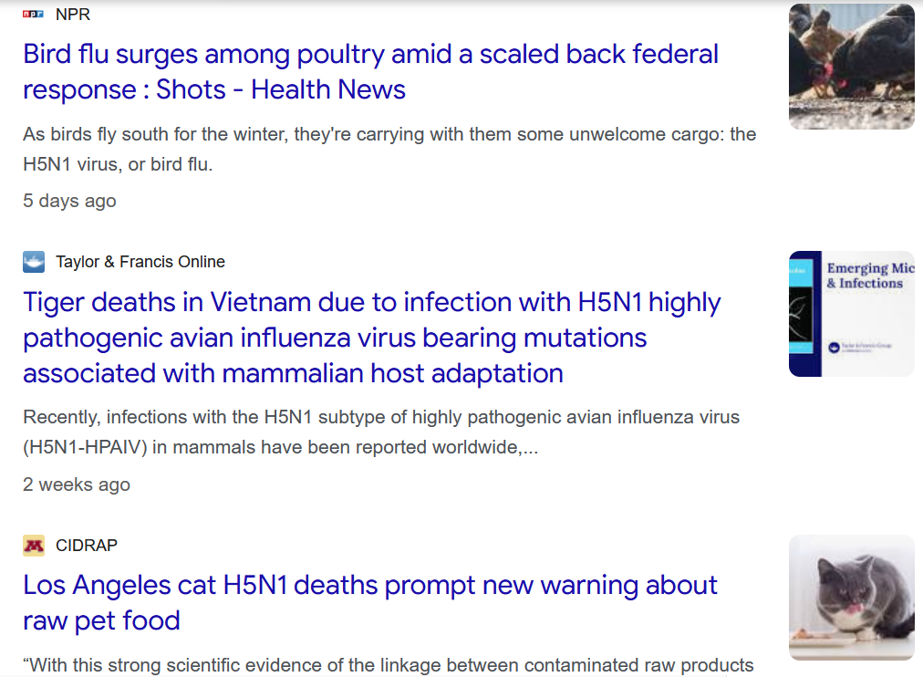
In 2025, US Department of Health and Human Services revoked federal research grants on mRNA vaccines including $700 million contract to drugmaker Moderna to develop a vaccine against bird flu.
Many scientists regard mRNA shots as best option for protecting Americans in a pandemic.
Notes:
https://www.nytimes.com/2025/08/05/health/rfk-jr-vaccine-funding.html
mRNA shots instruct the body to produce a fragment of a virus, which then sets off the body’s immune response

